Slide 1
IT & Technology M&A update
Quarter 1 2024

Slide 2
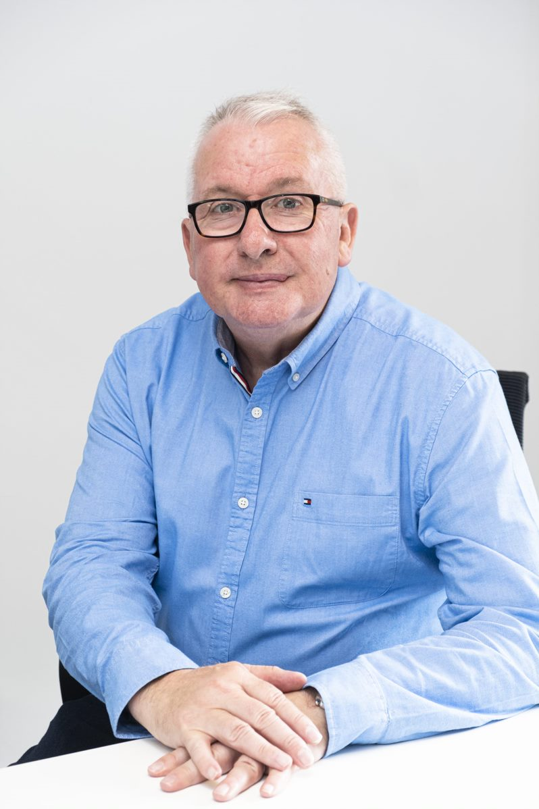
Lexington’s key highlights
Strong start seen for the UK IT & Technology M&A market in 2024
The first quarter of 2024 saw a total of 148 deals complete in the UK IT & Technology sector. This reversal of the downward trend that persisted throughout 2023 has been underpinned by the stabilisation of both interest rates and inflation, suggesting there is increasing confidence of market participants of the current UK political landscape.
Appetite from overseas strategic trade and Private Equity has been particularly hot. Perhaps a result of the relative current weakness of the pound against foreign currencies making UK targets more attractive in value terms, particularly for acquirers in developed markets such as mainland Europe, the Nordics and the US. Despite the economic headwinds brought on by Brexit, the UK remains an attractive hub for US trade and PE to begin wider European expansion strategies.
Overall, Q1 2024 got off to strong start for deal activity in this sector which is a common theme that can be seen in the first quarter of recent years. Our outlook for the remainder of 2024 remains positive, and a key area where we expect to see continued deal activity is the Managed Services Provider (MSP) market as cloud migration and cybersecurity solutions become increasingly more integral to UK businesses in all sectors (more detail can be found on page 8).
With the impending UK election drawing closer, we may see a short term burst in deal activity in the sector and wider market as the anticipation of a potential rise in Capital Gains Tax may encourage Shareholders to accelerate their exit plans to mitigate any rate increase.
We also expect the adoption of enterprise and digital workflow platforms such as ServiceNow, Salesforce and PipeDrive to continue increasing significantly. Making partners of these platform providers attractive targets to large trade players and PE alike due as to their fast scale up potential and extensive client bases.
148 completed deals in the quarter. 46% of which were Private Equity investments
Total publicly disclosed deal value exceeds £2.8bn
Publicly disclosed median deal values rise for third consecutive quarter to £19m
Uptick in quoted company EBITDA multiples from Q1 2023, implying increased confidence in the market
Lexington’s IT & Technology M&A team
Nigel Griffiths
Commercial Director
Thomas Edwards
Director
Jade Burgess
Executive
Charlie Lesbirel
Senior Associate
Ioan Brigden
Associate
Source:

Slide 3
Quarterly activity snapshot
Uptick in median deal value despite downward trend in volumes
Key themes:
Deal volume has increased in Q1 2024 from Q4 2023, with a total of 148 completed deals. This represents a 25% increase over the previous quarter. Notably, the long-term downtrend is slowing, with the decline from Q1 2023 to Q1 2024 at 13%, compared to a 22% decline from Q1 2022 to Q1 2023.
The median average deal value of the publicly disclosed deals in Q1 2024 increased to £19m, which is an increase over the previous quarter of 58%. Q1 2024 median average deal value is up 90% on Q1 2023. Lexington’s analysis in Q4 2023 tech M&A report suggested a resurgence of valuations in the sector, which has occurred- evidenced by two key metrics;
Median value increase from £10m in Q1 2023 to £19m in Q1 2024
Quoted UK tech companies’ EV/EBITDA multiple increase from 12x in Q1 2023 to 14x in Q1 2024 in the Lexington IT & Technology Index (page 9)
Source: Mergermarket and Lexington analysis

Slide 4
IT & Technology M&A sub-sector analysis
Continued growth seen in the number of cyber security in deals in Q4 2023
Fintech
Cyber security
15 fintech deals were announced in Q1 2024, up from the last quarter by 15%.
80% of the fintech deals this quarter had PE involvement.
The most notable transaction in the sub-sector was the minority investment in Monzo, a leading online bank, acquired by a consortium of investors.
10 cyber security deals were announced in Q1 2024, up from the last quarter in 2023 by 25%.
60% of the cyber security deals this quarter has involved a PE buyer.
Valuations in this sub-sector remain strong, with multiples significantly exceeding the market average. We expect this to remain the case throughout 2024.
Data processing
10 data processing deals were announced in Q1 2024, down from the last quarter by 9%.
50% of the data processing deals this quarter involved a PE buyer.
The most notable transaction in the sub-sector was the acquisition of GSS, a data processing Company specialising in screening sanctions, acquired by a group of investors for a consideration of £37m.
Q1
2024
Software development
4 software development deals were announced in Q1 2024, up from the last quarter by 12%.
54% of the software development deals this quarter has involved a PE buyer.
This sub-sector remains as leader of UK tech M&A activity. The most notable transaction in the sub-sector was the acquisition of Jagex, a video game developer headquartered in Cambridge, acquired by CVC Capital Partners in February 2024.
IT consulting & other
32 IT consulting & other deals were announced in Q1 2024, significantly up from the last quarter by 213%.
23% of the IT consulting & other deals this quarter had involved a PE buyer.
The most notable transaction in the sub-sector was the acquisition of Kerv, an IT consulting Company, acquired by Bridgepoint, for a consideration of £250m (further detail on page 7).
Application software
35 deals were announced in Q1 2024, up from the last quarter by 25%.
38% of the application software deals in this quarter has involved a PE buyer.
The acquisitions of application software Companies were predominantly lower middle market with 93% of the disclosed deal values below £30m.
Source: Mergermarket and Lexington analysis

Slide 5
Trade v PE
Strategic trade deal volumes up 23% in Q1 2024 from Q4 2023
PE transaction %:
27%
32%
39%
45%
46%
In Q1 2024, the UK IT & Technology sector announced 148 deals: 81 strategic trade deals and 67 PE deals. Overall deal volumes have increased by 27% on the previous quarter. While overall deal volumes have increased, deal values and EV/EBITDA multiples of quoted UK tech Companies has also increased, alongside the macroeconomic condition of the UK. In the quarter, the UK tech sector received significant investment from both domestic and international trade & PE buyers.
Trade transactions announced this quarter have increased by 23% on Q4 2023. Acquisitions to provide an expansion of service offerings continues to be a key driver of trade M&A activity, alongside inorganic growth strategies being restarting following an uncertain 6 months in the second half of 2023.
Private Equity deals continue to contribute significantly to the UK tech M&A market. 46% of the deals in this quarter were PE buyers of which 54% were international PE. UK IT & Technology continue to attract blue chip international investments with deals involving Blackrock, CVC, Bain Capital and many others. The implication for the sector following this investment from these blue-chip international investors is a confidence that the market will continue to grow and provide meaningful returns.
A look back: The historic split for trade vs PE transactions were dominated by trade in the IT & Technology sector. This trend has been changing since 2020 and has seen a shift to a more even split between trade and PE. Q1 2024 shows a 46% PE contribution to M&A activity, comparing this to 27% in 2020 is a suggestion that we should expect PE to form a significant role in the UK IT & Technology M&A market going forward.
Source: Mergermarket and Lexington analysis

Slide 6
Notable transactions – Trade
Recent strategic trade acquisitions in the UK IT & Technology sector
Data processing
Software development
January 2024
February 2024
Undisclosed
Undisclosed
EV/Revenue: N/A EV/EBITDA: N/A
EV/Revenue: N/A EV/EBITDA: N/A
Cyber Security
IT consulting & other
March 2023
March 2024
Undisclosed
Undisclosed
EV/Revenue: N/A EV/EBITDA: N/A
EV/Revenue: N/A EV/EBITDA: N/A
International acquirer
UK company acquirer
Appetite from overseas strategic trade acquirers remains strong in Q1. Demonstrated by the acquisition of London-based data processing and analytics specialist, Jarmany, by Ipsos, a leading market research company headquartered in Paris. Oshkosh Corporation, a US-based specialist purpose-built vehicle manufacturer, invested in Eatron Technologies in February 2024. Eatron is a Warwick-based developer of AI powered Battery Management Software. This acquisition is an example of the current pressing strategic need for companies in separate sectors looking to adapt and transform business models and service portfolios to embrace digitisation and automation in order to remain competitive in their respective markets.
Livingbridge backed cloud solutions provider, FluidOne, marked its eighth bolt-on during Livingstone’s tenure with the acquisition of SureCloud Cyber Services through FluidOne’s cyber security division, Cyber Security Associates (CSA). SureCloud Cyber Services was a divestment from SureCloud, and the acquisition takes the FluidOne group to £109m revenue and 500 employees, with over 50% of its operations being IT and Cyber Security.
Onecom made its first acquisition of 2024, which was of Excalibur Communications, an IT managed services provider that also provides unified communications (UC) and mobile services. This acquisition represents Onecom’s eleventh bolt-on since LDC acquired a minority stake in 2019. Onecom has also doubled in size since LDC’s investment, with most recent revenues exceeding £180m.
Source: Mergermarket, Lexington analysis

Slide 7
Notable transactions – Private Equity
Recent Private Equity deals in the UK IT & Technology sector
IT consulting & other
Software development
January 2024
February 2024
£250m
Undisclosed
EV/Revenue: N/A EV/EBITDA: N/A
EV/Revenue: N/A EV/EBITDA: N/A
Fintech
Software development
February 2024
March 2024
Undisclosed
£130m
EV/Revenue: N/A EV/EBITDA: N/A
EV/Revenue: N/A EV/EBITDA: N/A
International acquirer
UK company acquirer
One of the most significant Private Equity investments that took place in the quarter was BridgePoint’s investment in Kerv Group, a cloud-based IT consulting and managed services provider with operations throughout the UK, for a consideration of £250m. The investment took place in January 2024 and marks the sale of LDC’s majority position in Kerv. LDC did however retain a minority stake by reinvesting £30m into Kerv. The current UK managed services market is discussed further overleaf.
Software and technology focused PE house, Bowmark Capital, completed 4 investments in Q1 2024. Three bolt-ons, and one direct investment in February which was of CubeLogic. CubeLogic has developed a risk management SaaS solution for customers in the energy, commodities and financial services sectors. This transaction also sees CubeLogic embark on its secondary PE investment, as primary investors, Growth Capital Partners exited entirely after nearly four years of ownership.
Q1 international PE appetite remains buoyant from 2023 levels. Sweden-based PE, Nordic Capital, acquired a majority stake in ActiveViam, a London-based provider of data analytics solutions for the financial services sector from US growth capital firm, Guidepost Growth Management. Nordic Capital has highlighted M&A as part of ActiveViam’s growth strategy moving forward, so we may see a buy and build strategy develop as 2024 progresses for ActiveViam. US-based continued appetite for UK targets was demonstrated by Boston-based Great Hill Partners’ majority investment and combination of two employee benefits software platforms, Vivup and Perkbox, for a consideration of £130m in March.
Source: Mergermarket and, Lexington analysis
Note: All values presented are investment amounts

Slide 8
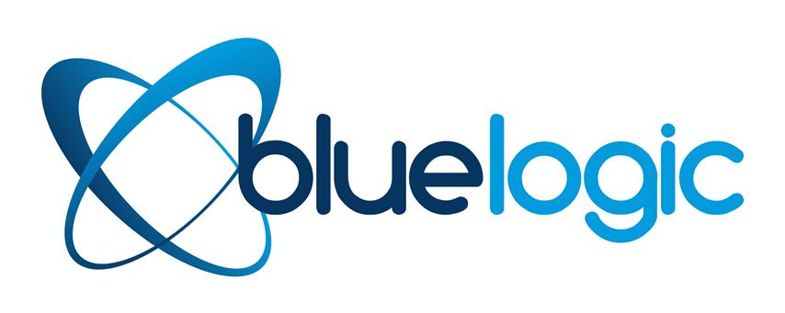
Focus on Managed Services Providers (MSP)
PE buy and build strategies in the MSP market
Overview
The UK MSP market has been a hotbed of PE activity. Buy and build strategies remain prominent, demonstrated by the volume of bolt-on additions each MSP platform has continued to complete, in particular:
Air IT was backed by August Equity in 2020. Air IT has made 12 bolt-on acquisitions since receiving this investment, with Lincolnshire-based SCS Technology Solutions being the latest addition in March 2024.
FluidOne was backed by LivingBridge in 2019. FluidOne has made 8 acquisitions since receiving its investment. FluidOne’s CEO, Russell Horton, has also recently outlined the Company's goal of making four new acquisitions annually on its way to becoming a £300m revenue business.
BCN was initially backed by Beech Tree in 2018, who exited to ECI in 2022. BCN has made 7 acquisitions since receiving the initial investment. Its latest investment in NewCMI will mean that BCN’s UK base now exceeds 1,200.
Backed by:
2020
2021
2022
2023
2024
Backed by:
2020
2021
2022
2023
2024
Market drivers and outlook
Lower mid-market deals are hot as the UK MSP market is highly fragmented, with a substantial number of SMEs. PE portfolio companies see opportunities to consolidate this market to acquire more depth, expand service offerings and geographical reach.
There is a continuous and growing need for IT support as the complexity of technology increases. Particularly as customers in all industries aspire to unlock the benefits of digital transformation, such as process automation and improved workflow efficiency.
Our outlook for the UK MSP market for the remainder of 2024 is that the level of activity seen historically will continue. As cloud migration and cybersecurity solutions become increasingly more integral to UK businesses, we expect manage services PE M&A activity to follow suit.
Entry:
Initially backed by:
2019
2020
2021
2022
2023
Source: Mergermarket and Lexington analysis

Slide 9
Quoted company benchmark multiples
The listed companies in the UK that are active in the IT & Technology sector
Overview
Lexington has identified 16 publicly traded IT & Technology firms in the UK and Ireland. The data shows that 50% of UK IT & Technology multiples have grown since Q4 2023, with Arcontech notably increasing by 38% and Intercede rising from 31.5x to 38.5x.
Despite a significant decrease in Capita's EV/EBITDA multiple, which fell from 13x last quarter to 3.7x this quarter, the average LTM EBITDA multiple across the 16 companies increased from 12x in Q1 2023 to 14x in Q1 2024.
The sustained outperformance of the UK IT & Technology sector over the market is underpinned by the continuation of increasing demand of digital consulting services, as well as the increasing mission critical status that cybersecurity is receiving. The combination of these factors along with scalability of these services, allows growth at a scale that is not generally possible when comparing with sectors such as manufacturing. Due to the convergence of these factors, we can expect to see a continuation of highly valued companies and high levels of growth in the UK IT & Technology sector.
Average LTM EBITDA Multiple
Q1 2023
12x
Q1 2024
14x
● Cyber security  Software development  Application software products  IT consulting and other  Fintech
Source: S&P CapIQ and Lexington analysis

Slide 10
Tech v FTSE index
The IT & Technology sectors continues to be one of the UK’s outperforming industries in Q4 2024
Covid impacted
The above graph illustrates how the IT & Technology market has performed against the market as a whole. We have compared the performance of the FTSE techMARK All-Share Index and our own tech index (which includes the 16 quoted companies, see page 9) against the FTSE All-Share Index. The techMARK All-Share Index tracks the performance of all quoted large cap to lower mid-market IT and technology companies included in the Financial Times Stock Exchange Group (FTSE).
In Q1 2024, the Lexington IT & Technology index saw positive movement throughout the quarter, rising by over 30% before falling to base level at the start of Q1 2024. Comparing this to the FTSE all-share index which steadily increased by c.4%. The tech market usually follows the broader market's movements, at an increased value, but the Lexington IT index showed high volatility compared with the all-share index.
Source: S&P Capital IQ

Slide 11
Who we are
Corporate Finance advisory boutique with focus on the IT & Tech mid-market
Breadth of transaction skills
Excellent track record
Mid-market Tech focus
An entrepreneurial, corporate finance advisory boutique, providing hands-on, trusted advice to businesses, owners and investors with growth, succession and buyout ambitions.
www.lexingtoncf.co.uk
Dedicated & professional senior team
Trade-sale and Private Equity expertise
Flexible & collective approach

Slide 12
Feedback from the clients we work with
We are really proud of the testimonials we receive from our clients
Lexington advised the shareholders of Evo-Soft, a Microsoft Dynamics 365 specialist, on its sale to BCN Group
“The BCN acquisition provides a true opportunity for Evo-Soft to continue its growth as a leading Microsoft Dynamics 365 Business Central solutions provider, and represents a huge milestone in Evo-Soft’s successful history. Lexington’s services have been invaluable to us throughout every step of the sale process, and I’d have no hesitation in recommending them or using their services again.”
Ashley McIntyre,
Managing Director
Lexington advised the shareholders of Redcortex, a digital transformation consultancy, on the sale to TPX Impact PLC
“Lexington really helped us through this process, providing invaluable advice at every step and helping make sure we achieved a good valuation for RedCortex. The Lexington team made sure the transaction ran smoothly and kept us informed at every stage.”
Martin Britton,
Executive Director and Founder
Lexington advised the shareholders of DevOpsGroup, a cloud services consultancy, on the sale to Amdocs
“Lexington were an excellent corporate finance partner. They took time to understand what support and guidance we needed, and provided invaluable advice throughout the process. The team were professional and easy to work with, always available when needed and the clear and frequent communication throughout, delivered an extremely successful outcome for DevOpsGroup.”
James Smith,
Chief Executive
Lexington advised the shareholders of CashCalc, a cashflow planning provider, on the sale to FE fundinfo (backed by HG Capital)
“We’re delighted to join the FE fundinfo family and we’d like to thank Lexington for all the work they put into making this happen. Thomas and Pablo were both efficient and effective and we would highly recommend them. Everyone at CashCalc is incredibly excited, so a big thank you from all of us.”
Ray Adams,
Director and Founder

Slide 13
Nigel Griffiths – Commercial Director
ngriffiths@lexingtoncf.co.uk
07771 756 032
Thomas Edwards – Director
tdmedwards@lexingtoncf.co.uk
07432 053 868
If you would like to learn more about our services and how we can assist you in your growth journey or exit, please don’t hesitate to get in touch with any member of our technology team
Jade Burgess – Executive
jburgess@lexingtoncf.co.uk
07377 500 976
Charles Lesbirel – Senior Associate
clesbirel@lexingtoncf.co.uk
07539 986 698
Ioan Brigden – Associate
ibrigden@lexingtoncf.co.uk
07940 162 664

